Slide 1
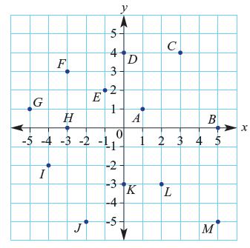
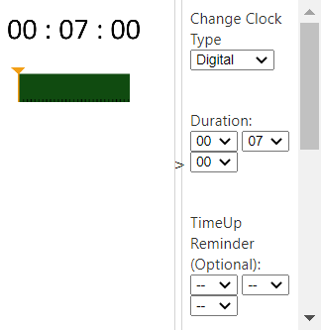
Starting Questions
Write the coordinates:
A:
C:
E:
H:
I:
K:
M:
Write your summary for last lesson
Notes:
Give them time to write what they know on the left hand side.
How you get the info off them is up to you, TPS, popcorn etc.

Slide 2
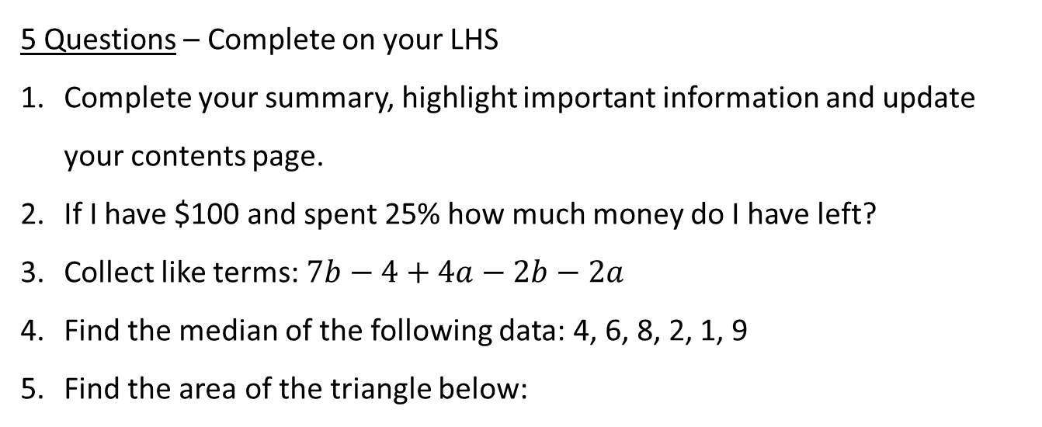

Topic: Linear Relationships
EQ – How do you draw a graph from a table?
Date: XX/XX/2021
5 Questions – Complete on your LHS
Complete your summary, highlight important information and update your contents page.
If I have $100 and spent 25% how much money do I have left?
Collect like terms: $7b−4+4a−2b−2a$
Find the median of the following data: 4, 6, 8, 2, 1, 9
Find the area of the triangle below:
7 cm
6 cm

Slide 3
My Linear Relationships Interactive Notebook
Name:
Class:
Teacher:
Semester 2
Term 3
1

Slide 4
24
7
30
Topic: Linear Relationships
Date
EQ – How do you draw a graph from a table?

Slide 5
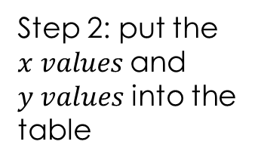
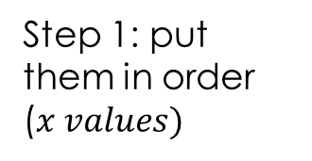
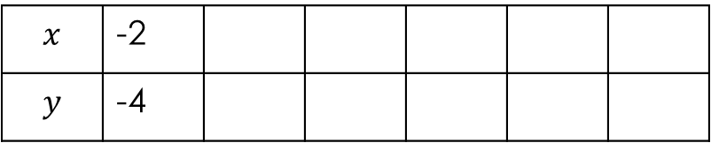
24
7
30
Topic: Linear Relationships
Date
EQ – How do you draw a graph from a table?
How do we put coordinates in a table?
Coordinates can also be written in a table to organise them and make them easier to graph.
Step 1: put them in order ($x values)$
Step 2: put the $x values$and $y values$ into the table
Consider the following set of coordinates:
(0, -2) (3, 1) -1, -3)
(1, -1) -2, -4) (2, 0)
Consider the following set of coordinates:
(0, -2) (3, 1) (-1, -3)
(1, -1) (-2, -4) (2, 0)
(-2, -4) (-1, -3) (0, -2) (1, -1) (2, 0) (3, 1)
-1
-3
0
-2
$$x$$ | -2
$$y$$ | -4

Slide 6

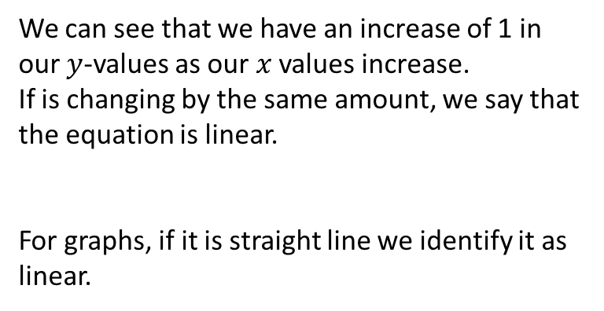
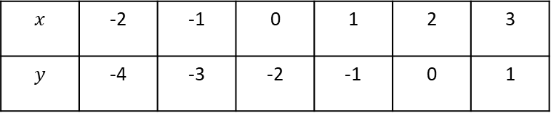
24
7
30
Topic: Linear Relationships
Date
EQ – How do you draw a graph from a table?
How do we know if this is linear?
$$x$$ | -2 | -1 | 0 | 1 | 2 | 3
$$y$$ | -4 | -3 | -2 | -1 | 0 | 1
1 1 1 1 1
We can see that we have an increase of 1 in our $y$-values as our $x$ values increase.
If is changing by the same amount, we say that the equation is linear.
For graphs, if it is straight line we identify it as linear.

Slide 7
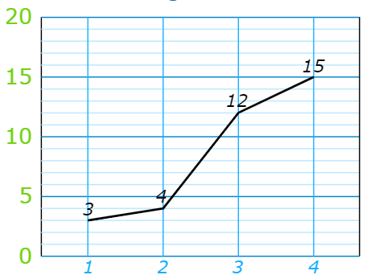
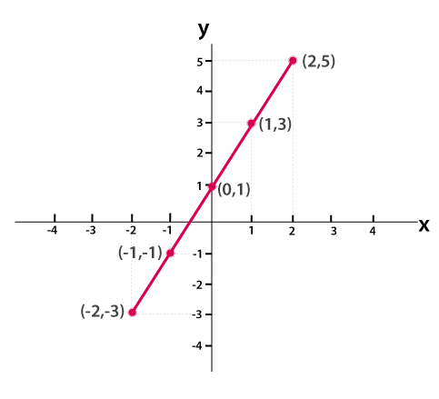
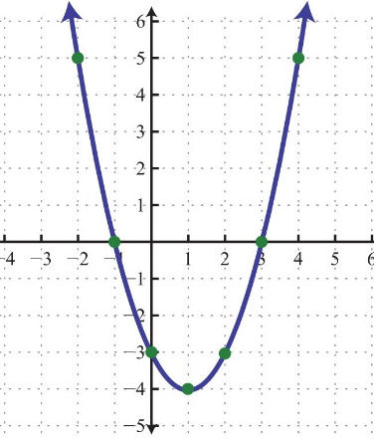
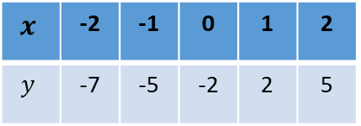
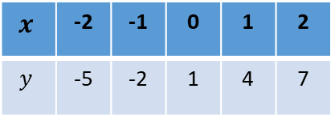
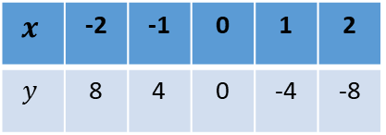
Complete on your LHS Identify which of these are linear
4.
5.
6.
1.
2.
3.
$$x$$ | -2 | -1 | 0 | 1 | 2
$$y$$ | -5 | -2 | 1 | 4 | 7
Not Linear
Linear
Not Linear
Known as a parabola
Linear
Not Linear
Linear
$$x$$ | -2 | -1 | 0 | 1 | 2
$$y$$ | -7 | -5 | -2 | 2 | 5
$$x$$ | -2 | -1 | 0 | 1 | 2
$$y$$ | 8 | 4 | 0 | -4 | -8

Slide 8
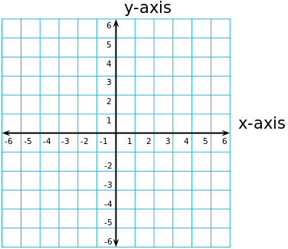
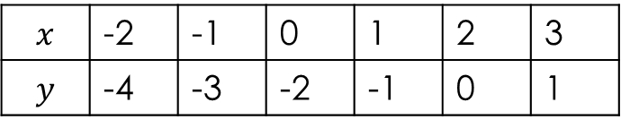
24
7
30
Topic: Linear Relationships
Date
EQ – How do you draw a graph from a table?
How do we graph points from a table?
$$x$$ | -2 | -1 | 0 | 1 | 2 | 3
$$y$$ | -4 | -3 | -2 | -1 | 0 | 1

Slide 9
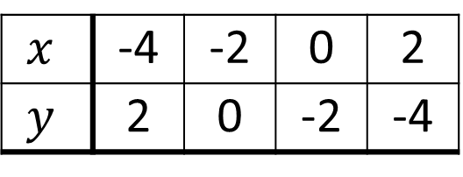
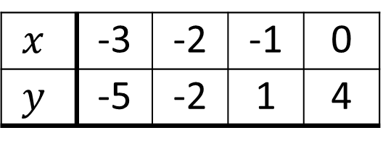
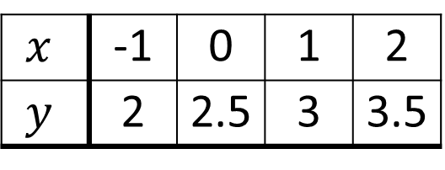
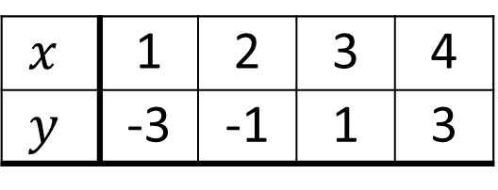
Your Turn (LHS of course)
Worksheet
(a)
$$x$$ | 1 | 2 | 3 | 4
$$y$$ | -3 | -1 | 1 | 3
(b)
$$x$$ | -1 | 0 | 1 | 2
$$y$$ | 2 | 2.5 | 3 | 3.5
(c)
$$x$$ | -3 | -2 | -1 | 0
$$y$$ | -5 | -2 | 1 | 4
(d)
$$x$$ | -4 | -2 | 0 | 2
$$y$$ | 2 | 0 | -2 | -4

Slide 10


Do you understand?
Notes:
Check for Understanding

Slide 11

Your Turn
Dwyer 162 and 163
Left Hand Side

